Slide 1
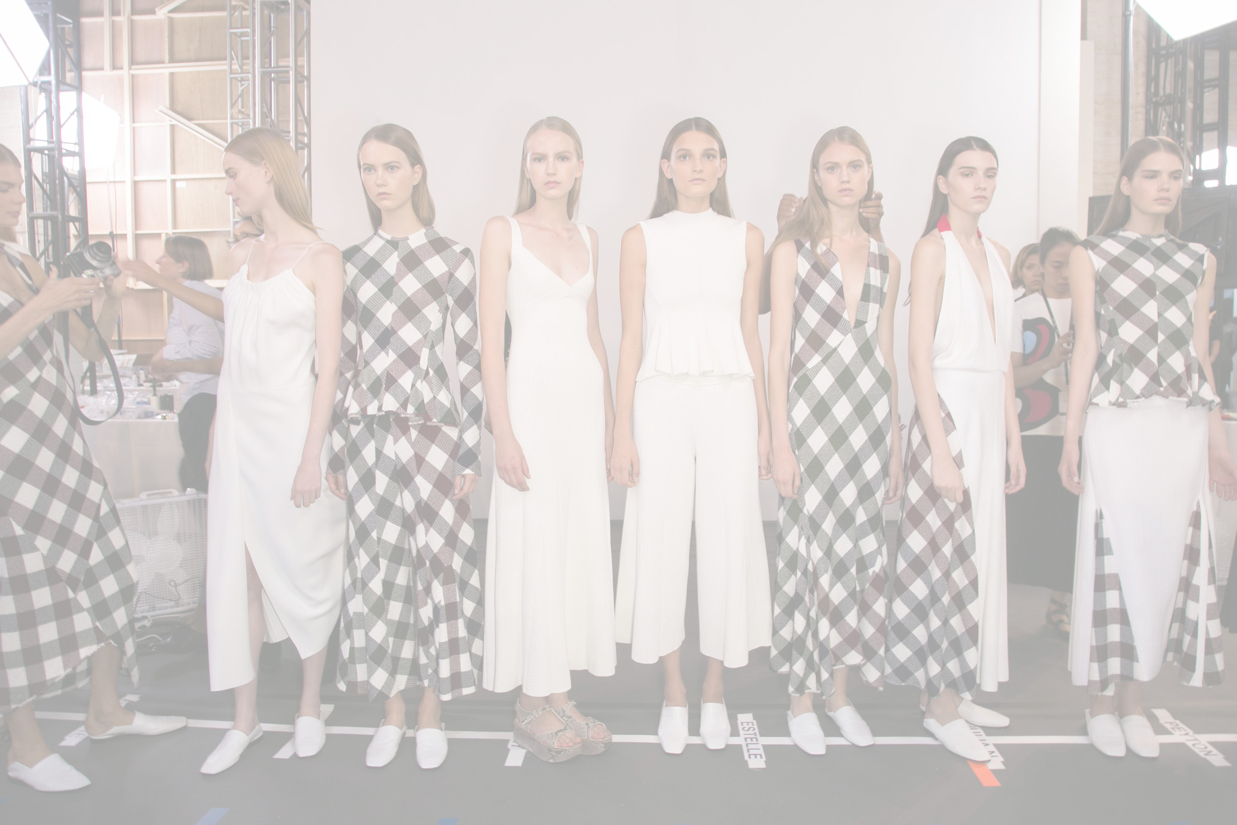
Introduction to Fabric

Slide 2









Slide 3

What we will cover today
- Different fabric categories
- Yarn types
- Fibre types
- Fabric density
- Selecting appropriate fabric for the desired end use
- Fabric construction and affect on the price
- Composition and affect on the price
- Reasons for minimum quantities
- Reducing cost of garments through fabric engineering

Slide 4

Fabric Categories
Fabrics fall into one of the following categories:
- Woven
- Knitted
- Non woven

Slide 5

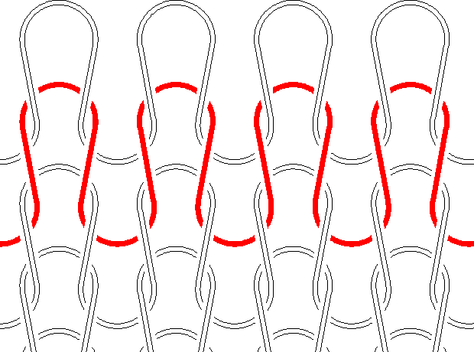
Fabric
- A fabric is created when yarns are woven or knitted together
- The amount of yarn in a fabric is referred to as it’s density which is normally measured per inch
- On woven fabrics, the density is the number of ends and picks in an inch (for example 120x80)
- On knitted fabrics, the density is the number of courses and wales in an inch
- The higher the density of the fabric, the heavier the weight (GSM)
- You can have very dense fabrics that are very lightweight, if they are using fine yarns

Slide 6

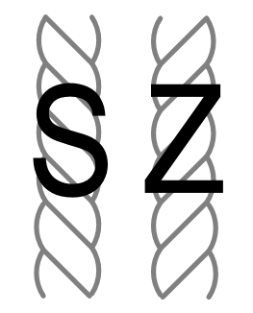
Yarn
- Yarns are produced from fibres that are spun together
- You can have a filament fibre (unbroken) or a staple fibre (cut to length)
- Have a look at the fabrics on the table, what do you think these are?
- The filament or staple fibres are spun together into yarns of varying thickness in either an S twist or a Z twist

Slide 7

Yarn
Yarns are measured by thickness in two ways:
staple
thickest
thinnest
filament
thickest
thinnest

Slide 8

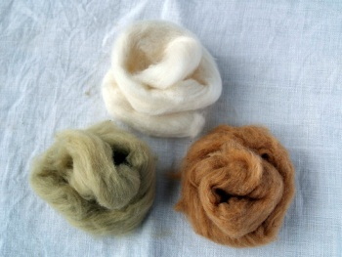
Fibre
Fibres can fall into one of 3 categories:
- Natural
    Taken directly from a natural source
- Man-made/Regenerated
    Formed from a natural material but chemically restructured
- Synthetic
    Chemically created from artificial source
- Which of these families do you think the fabrics you have fall into?

Slide 9

Fabric samples
- From the fabric samples you have, discuss how these differ from one another
- It can be; composition, density, yarn count, knit or weave construction, or a combination of all of these

Slide 10

Summary
- Fibre - the single strand of material that is the starting point of a yarn
- Yarn - the result of twisting fibres together into a long, unbroken strand
- Fabric - the result of connecting yarns together through knitting or weaving
- Warp (ends) - the set of yarns in a woven fabric that run in the length direction
- Weft (picks) - the set of yarns in a woven fabric that run in the width direction
- Twist - the method in which yarns are formed
- Courses - the lengths of yarn that run across the width of a knitted fabric
- Wales - the vertical lines that run down the length of a knitted fabric
- Density - the amount of yarn that is in a fabric (measured in ends/picks or courses/wales)

Slide 11

How can fabric affect the cost of a product?
- Fabric construction and affect on the price
- Composition and affect on the price
- Colouring method and affect on the price
- Prints and hidden costs
- Reasons for minimum quantities
- Reducing cost of garments through fabric engineering

Slide 12
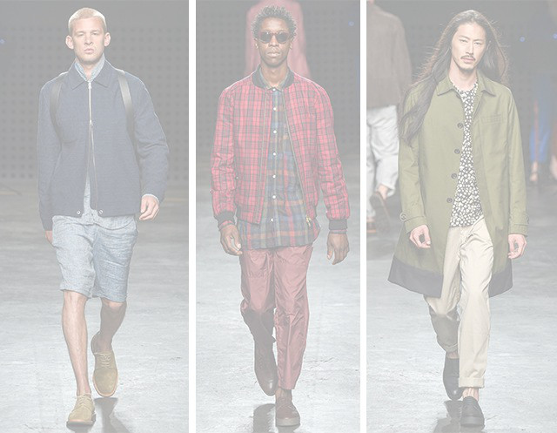
Yarns
The yarn count can affect the price of a fabric
Staple spun yarns
1/10 | 1/24 | 1/30 | 1/40 | 1/50 | 2/80 | 2/100
cheapest
most expensive
Filament yarns
250D | 200D | 150D | 100D | 75D | 25D | 1D
cheapest
most expensive

Slide 13
Fabric weight
- Heavier fabrics are normally more expensive than lighter fabrics because?
- However some very fine fabrics may be more expensive due to the cost of the yarns used
Eg:
  1/30’s jersey at 220gsm is more expensive than 1/30’s jersey at 160gsm (because more yarn has been used)
  1/30’s jersey at 220gsm is potentially cheaper than 1/50’s jersey at 180gsm (because the 1/50’s yarn is much more expensive than 1/30’s yarn)

Slide 14

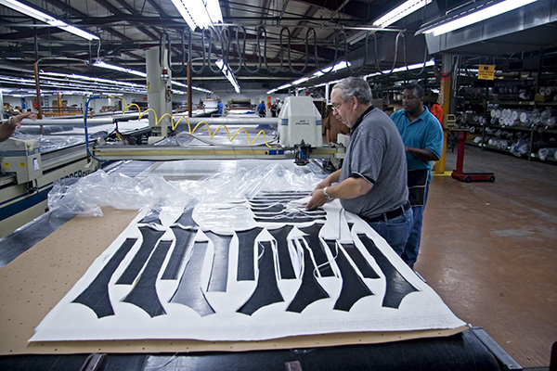
Fabric width
- What reasons can you think of as to why fabrics come in different widths?
- All fabrics are finished to a set usable width
- The wider the width, the higher the price, why do you think this is?
- You should always ask for the fabric width whenever you get the fabric price, why do you think this is?

Slide 15

Minimum buys
- Why do you think fabrics have minimum quantity requirements?
- Do you think woven fabrics or knit fabrics have a higher minimum. Why is this?
- Which type of print do you think has the highest minimum and why?

Slide 16

Exercise
From the garment samples you have brought with you, identify ways in which you think you can either reduce the cost price, or make the garment more premium
Concentrate on revisions to the fabric quality, or colouration method in order to get the same look, but at a revised price point
At the end, estimate how much fabric is in your garment

